Slide 1
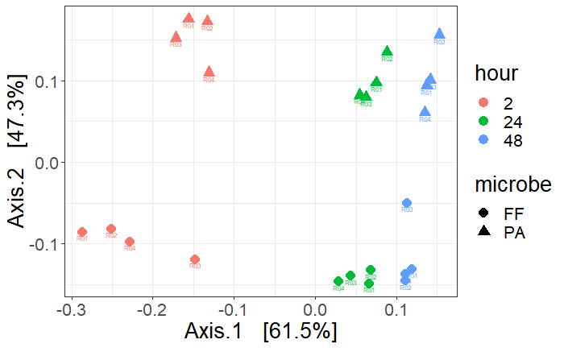
Multidimensional scaling (MDS) using principal coordinates analysis (PCoA) of a Bray-Curtis distance matrix comparing the volatile composition between Frigoribacterium faeni and Pantoea agglormerans. Microbes were inoculated into liquid LB broth and 10% blueberry juice and each solution contained only one microbe species. Marker shapes represent the microbes and colors represent the hour when volatiles were collected. Axis.1 explained 61.5% of the variance and Axis.2 explained 47.3% of the variance.

Slide 2
F. faeni target VOCs
P. agglomerans target VOCs
Carbonic acid, dimethyl ester
2-Nonanone
Benzene, 1,3-bis(1,1-dimethylethyl)-
Pyrazine, 3-ethyl-2,5-dimethyl-
Bicyclo[2.2.1]heptan-2-ol, 1,7,7-trimethyl-, (1S-endo)-
1-Propanol, 3-(methylthio)-
(-)-Myrtenol
3-Cyclohexene-1-ethanol, .beta.,4-dimethyl-
p-Mentha-1(7),8(10)-dien-9-ol
Eugenol
Disulfide, dimethyl
1-Butanol, 3-methyl-, acetate
Heptanal
2-Hexenal, (E)-
Acetoin
1-Heptanol
Furfural
1-Hexanol, 2-ethyl-
Benzonitrile
2-Furanmethanol
Mequinol
2H-Pyran-2-carboxaldehyde, 5,6-dihydro-
Phenol

Slide 3
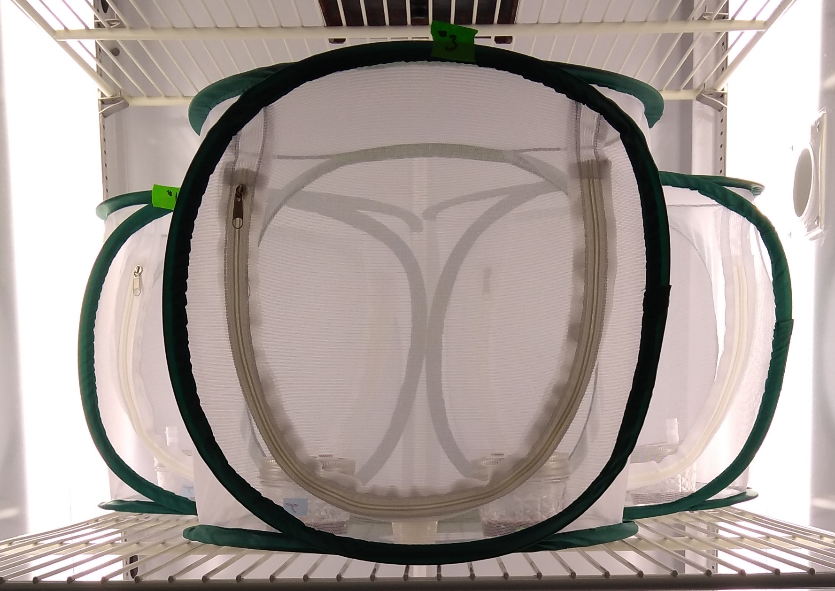
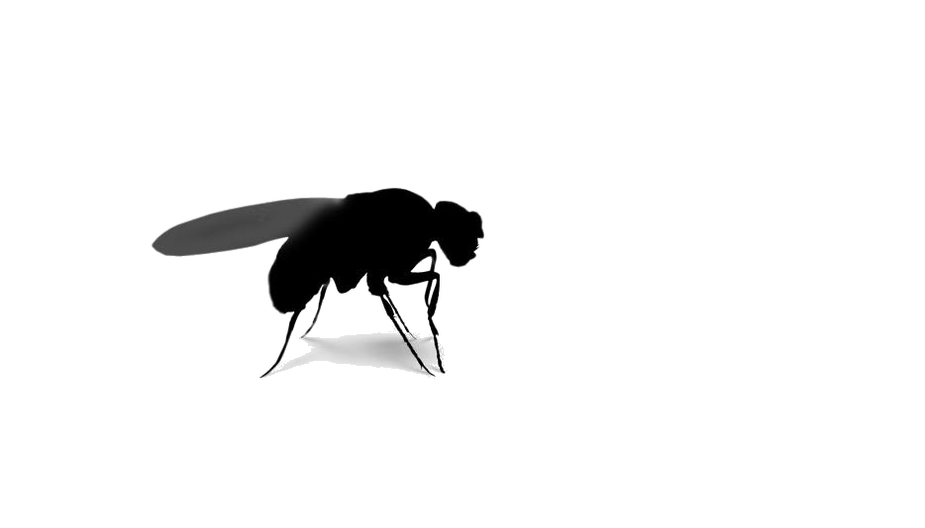
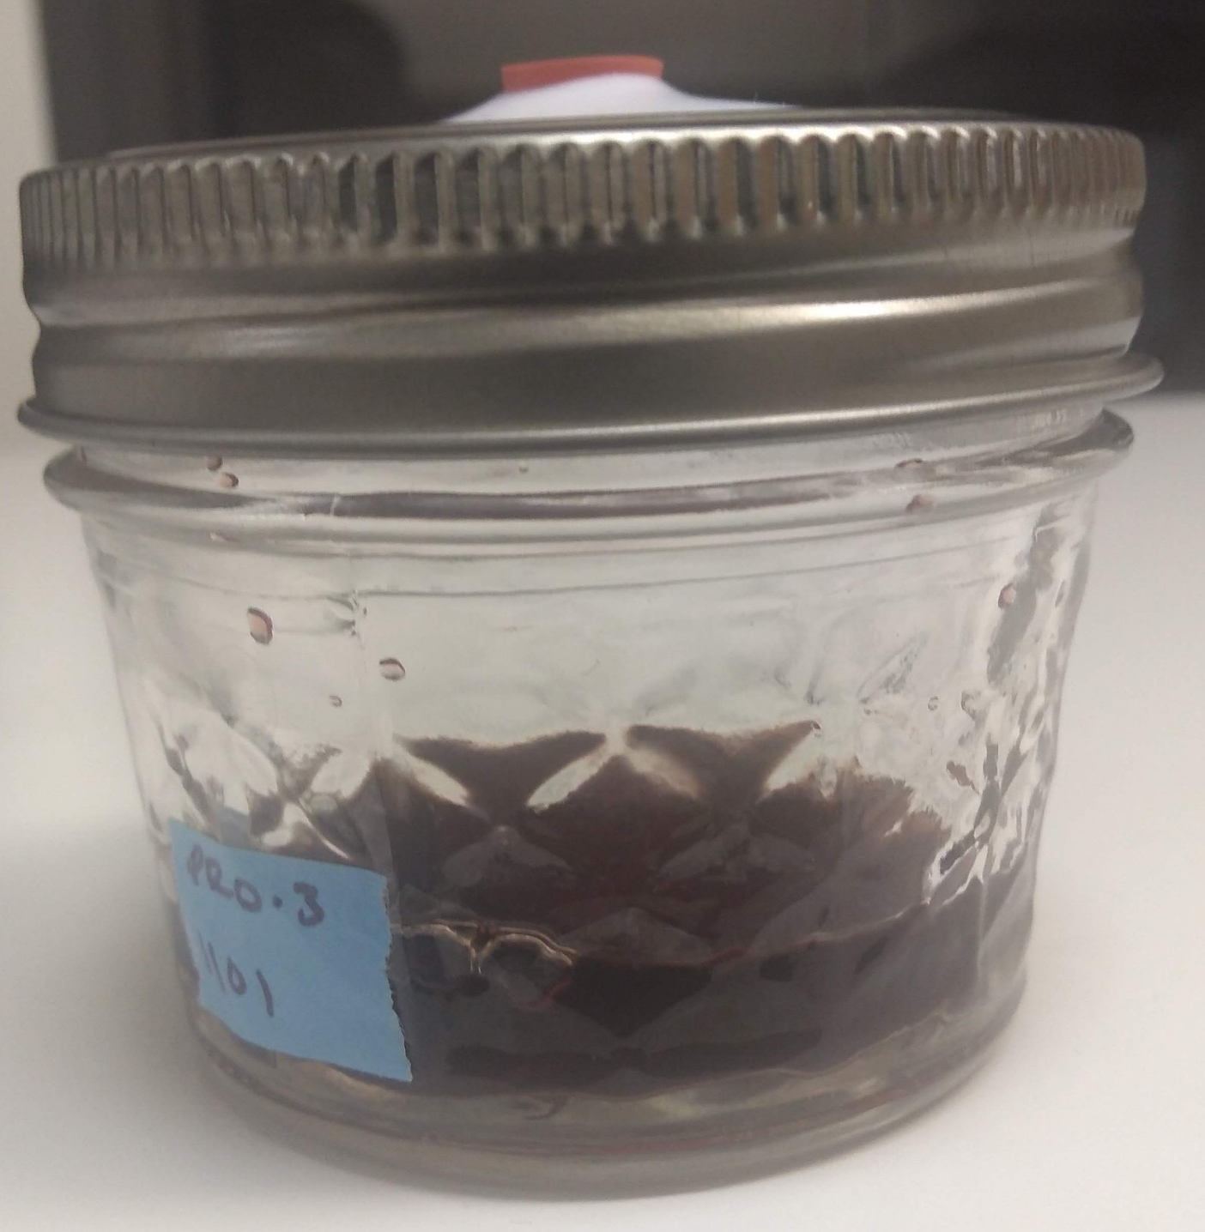
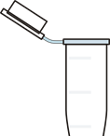
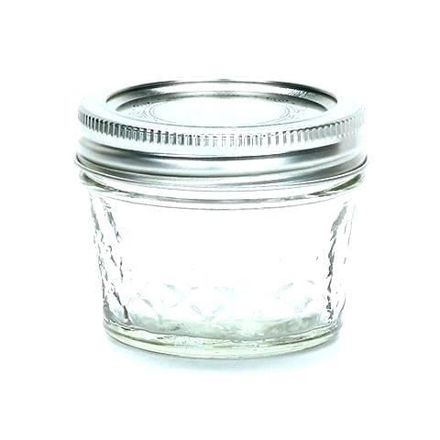
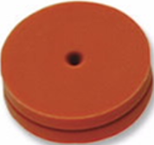
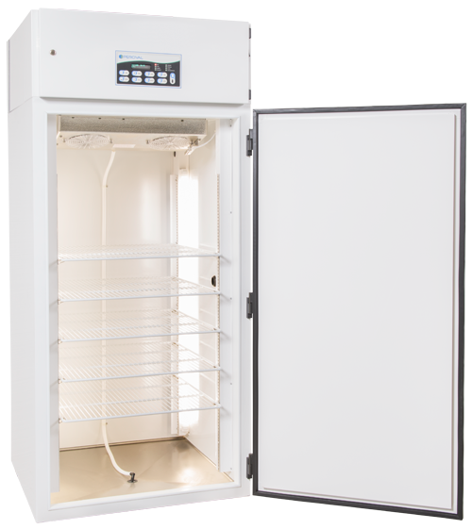
Equipment
Mesh Cages
Trap Jars
4 oz ball jar
Metal lid ring
Teflon lid cover with 2 holes
1 septa covered hole
1 hole plugged with a centrifuge tube
Incubators
25 C, 60% rH, and 16:8 L:D

Slide 5
Experimental Weeks: 1, 2, & 3
SWD Choice: Microbe vs Control
Frigoribacterium faeni
Pantoe agglomerans
1x
5 Cages Total:
1 Control Cage
1 Control Jar: 10% Juice
1 Treatment Jar: 10% Juice + Microbe
NO Flies
Treatment Cages
1 Control Jar: 10% Juice
1 Treatment Jar: 10% Juice + Microbe
50 SWD flies
1x
5 Cages Total:
1 Control Cage
1 Control Jar: 10% Juice
1 Treatment Jar: 10% Juice + Microbe
NO Flies
Treatment Cages
1 Control Jar: 10% Juice
1 Treatment Jar: 10% Juice + Microbe
50 SWD flies
7x
7x

